Slide 1
Front End Engineering-I Project
Team Details
Name | Roll No.
Prince kumar | 2210992090
Prince kumar singh | 2210992091
:
Mentor: Amandeep kaur
Chitkara University Institute of Engineering and Technology,
Chitkara University, Punjab

Slide 2
Table of Contents
Introduction
Problem Statement
Technical Details
Key Features
Project Highlights
Bonus Feature(optional)
Conclusion
References/Links used

Slide 3
Introduction
“Tribute page”
Team Details
Prince kumar Singh - 2210992091
Prince kumar - 2210992090
Guided by-Amandeep kaur

Slide 4
Purpose and Goals
A tribute landing page's aims to:
Describe the product: The Tribute page ought to give a summary of the famous personality.
Create interest: The user should be encouraged to learn more about the personality by the web page's ability to stimulate their interest in it.
Create trust: The webpage should demonstrate the legitimacy of the brand and the business that created it.
Educate the user: The tribute page should inform the user about how the page functions, how it resolves an issue, and how it might be useful to them.
Create leads: The product page should nudge the visitor to take some sort of action, like to know about our famous personality by their books.

Slide 5
Problem Statement
"Creating a tribute page in today's digital age can be challenging, as users have high expectations for both functionality and design. Students may struggle to balance the need for engaging content with technical skills in HTML and CSS, while also ensuring that the tribute page is accessible and compatible across different platforms and devices. Furthermore, students may face difficulties in determining the appropriate tone and level of detail for the tribute page, especially if the subject of the tribute is a sensitive or controversial topic. This presentation will explore these challenges and provide strategies for overcoming them in order to create an effective and meaningful tribute page."

Slide 6
Technical Details
1. HTML : The use of semantic HTML ensures that the page's content is properly structured and organized. This allows for easier accessibility and search engine optimization (SEO), as search engines can better understand the page's content and users can easily navigate through the page.
2. CSS : CSS was used to style the page's layout, typography, colors, and other visual elements. In creating a visually appealing and user-friendly tribute page, it is important to utilize effective typography, color schemes, and imagery to create an aesthetically pleasing design.

Slide 7
Key Features
1. Compelling headline: The headline of the tribute page is attention-grabbing and compelling, encourages the user to read on.
2. Visual design: The landing page is visually appealing and uses images, videos, and graphics to showcase the product and its features.
3. Clear value proposition: The tribute page communicates and
and helps the user to make the aware about our missile man of india.
Call-to-action (CTA): The tribute page has clear and compelling call to action, such as “buying books”, that encourages the user to take action.

Slide 8
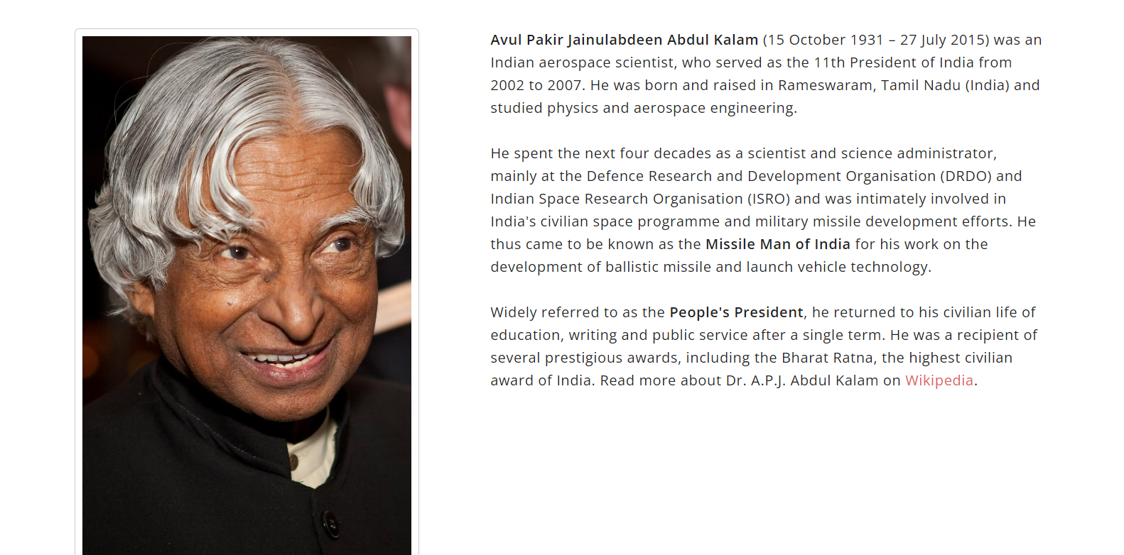
Project Highlights
Web Page Screenshots :

Slide 9
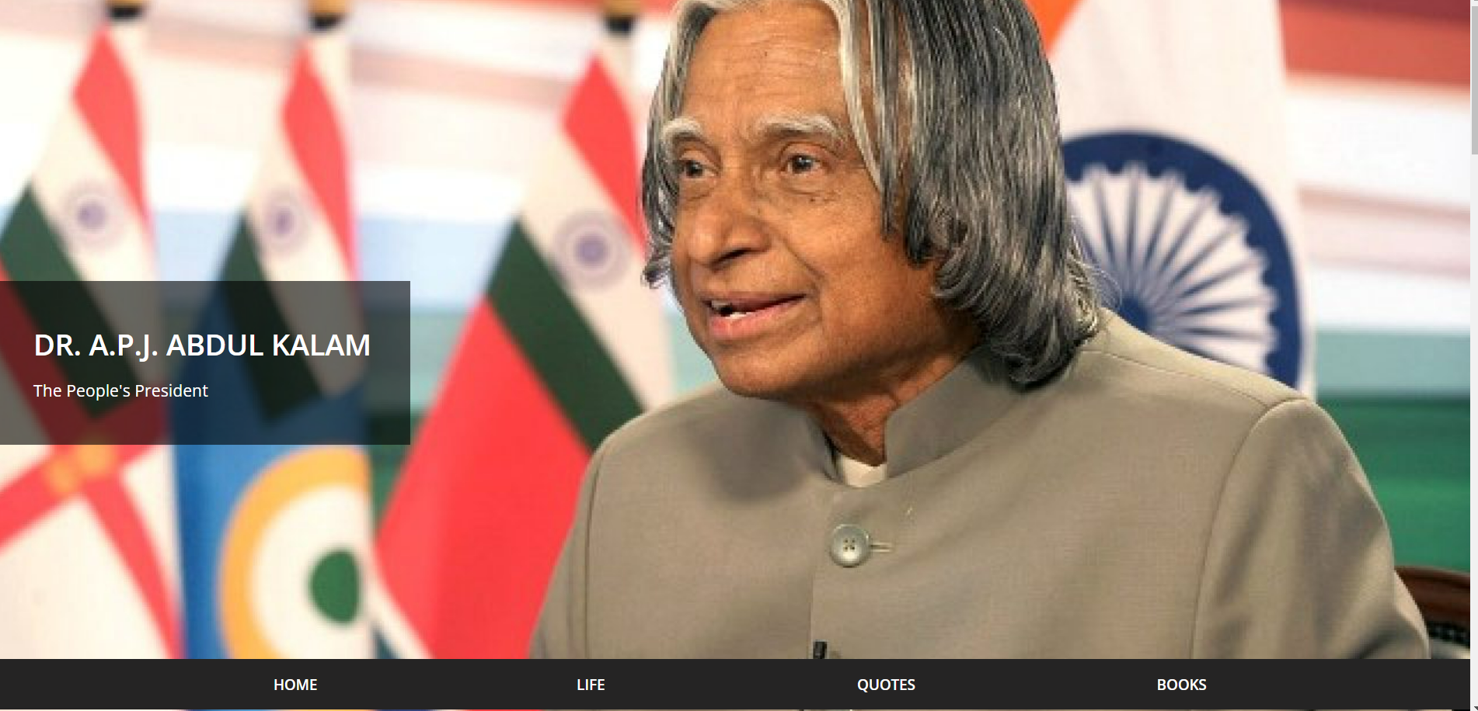

Slide 10
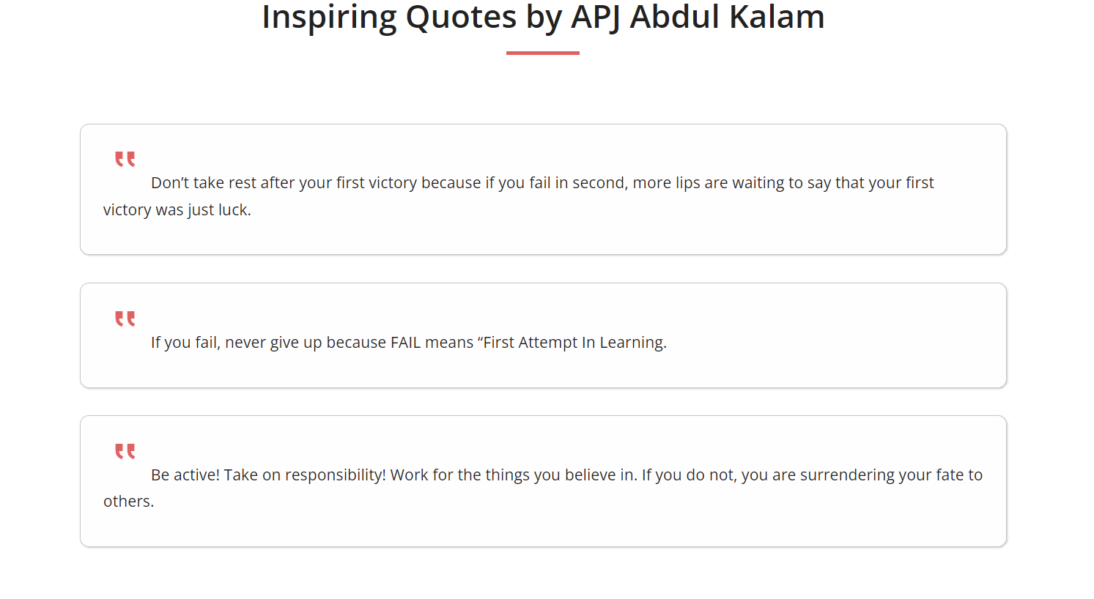

Slide 11
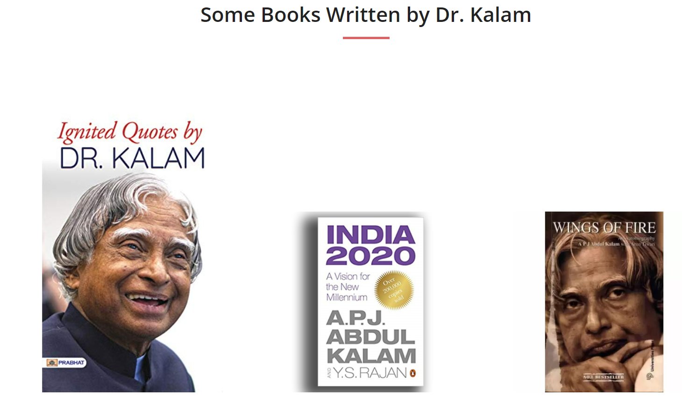

Slide 12
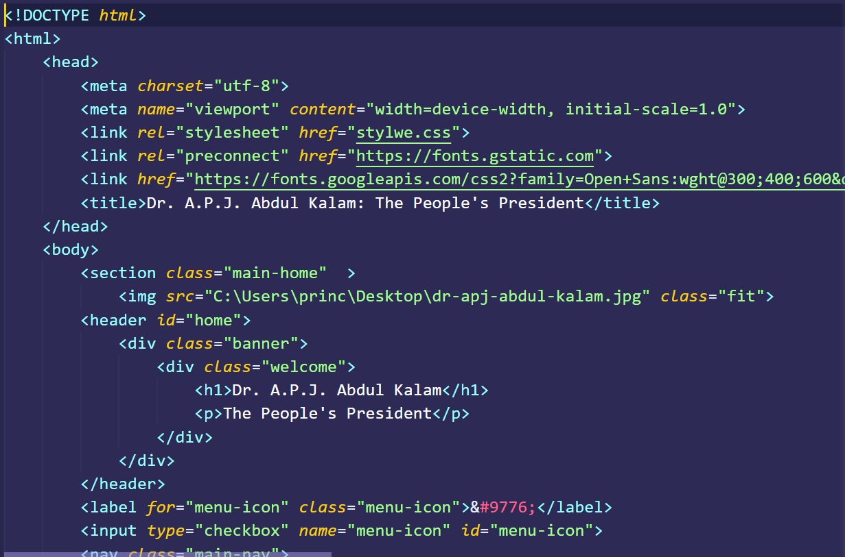
HTML Code :

Slide 13
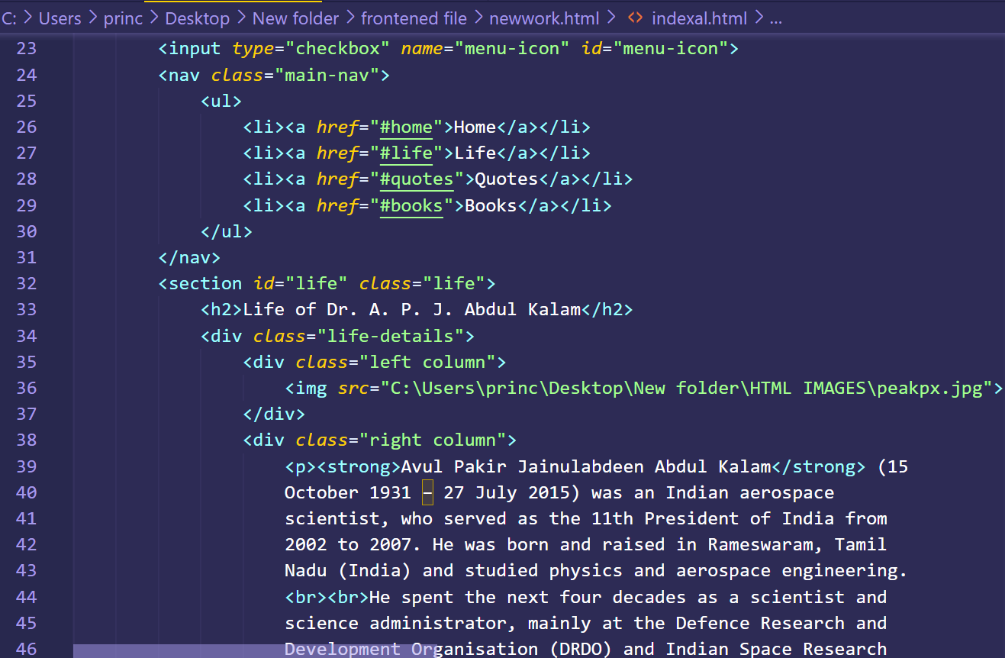

Slide 14
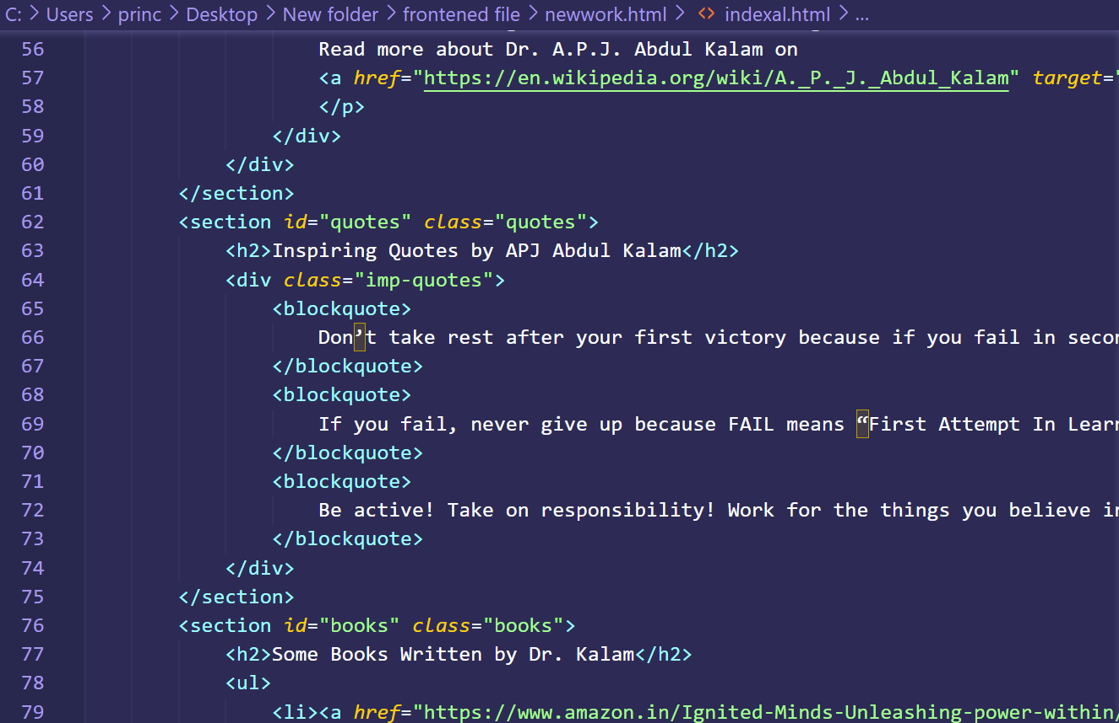

Slide 15
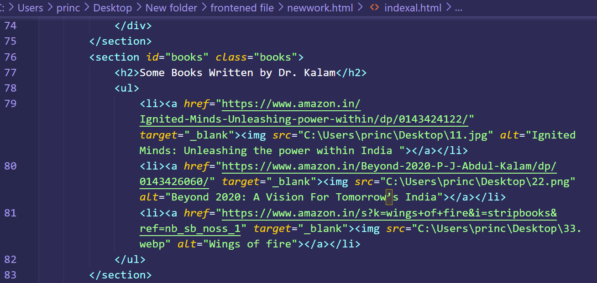

Slide 16
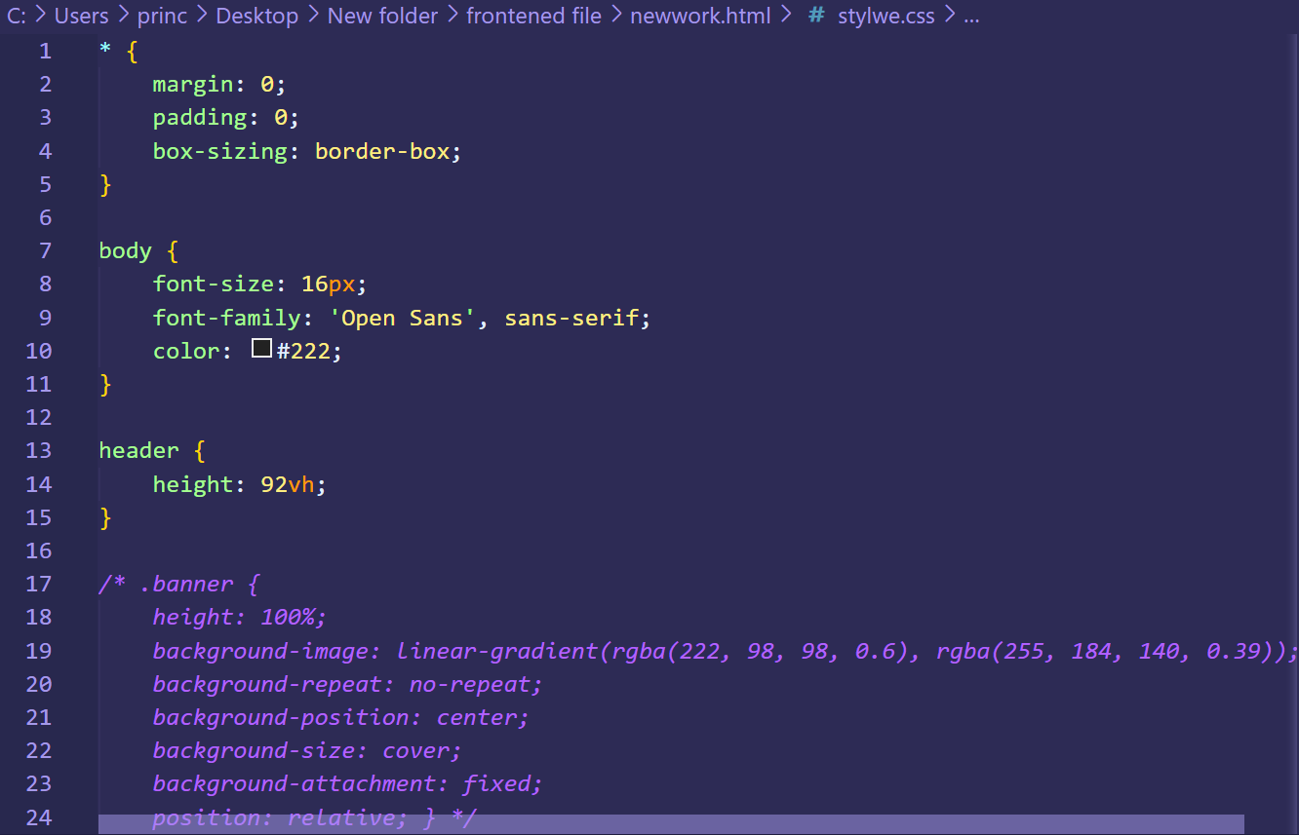
CSS Code :

Slide 17
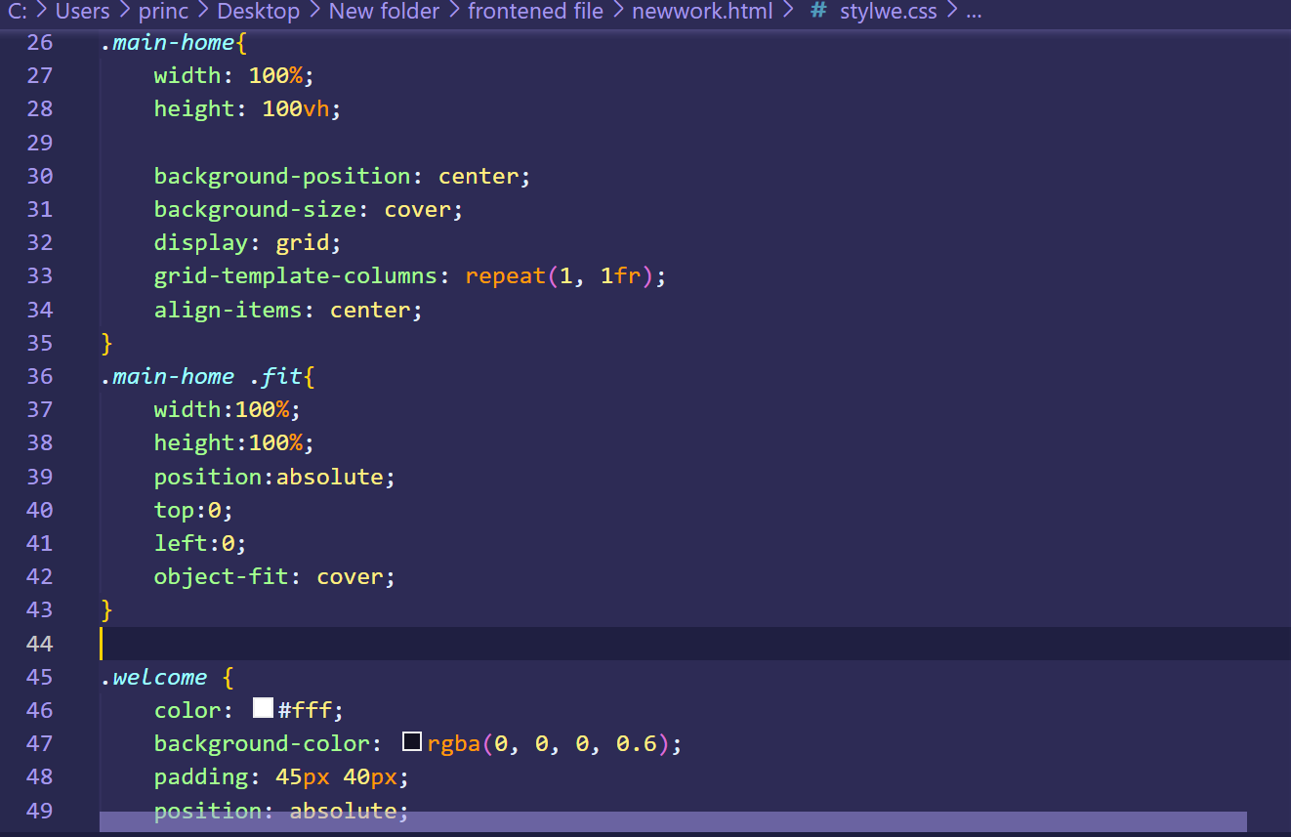

Slide 18
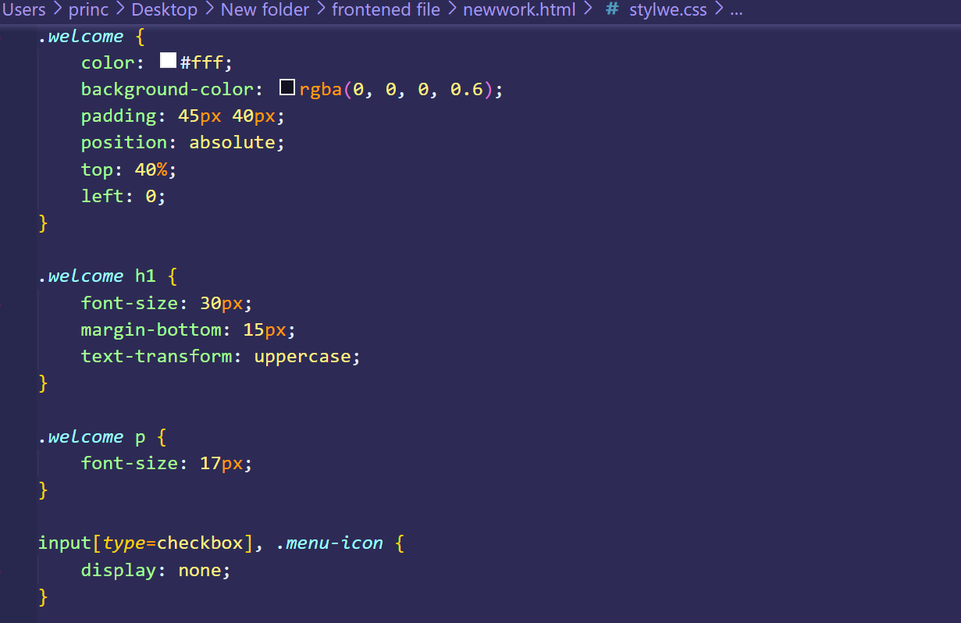

Slide 19
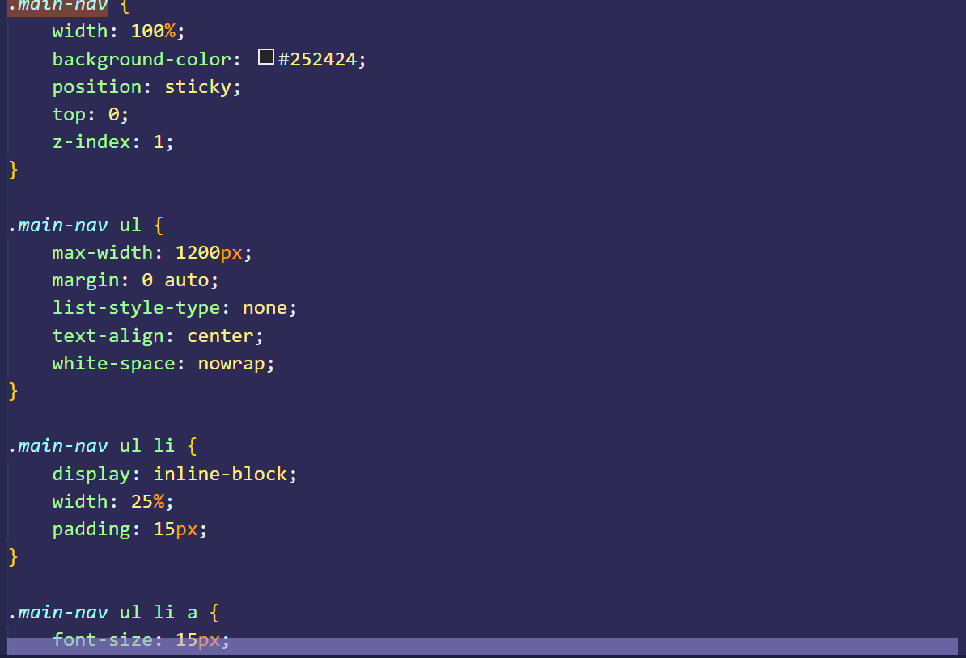

Slide 20
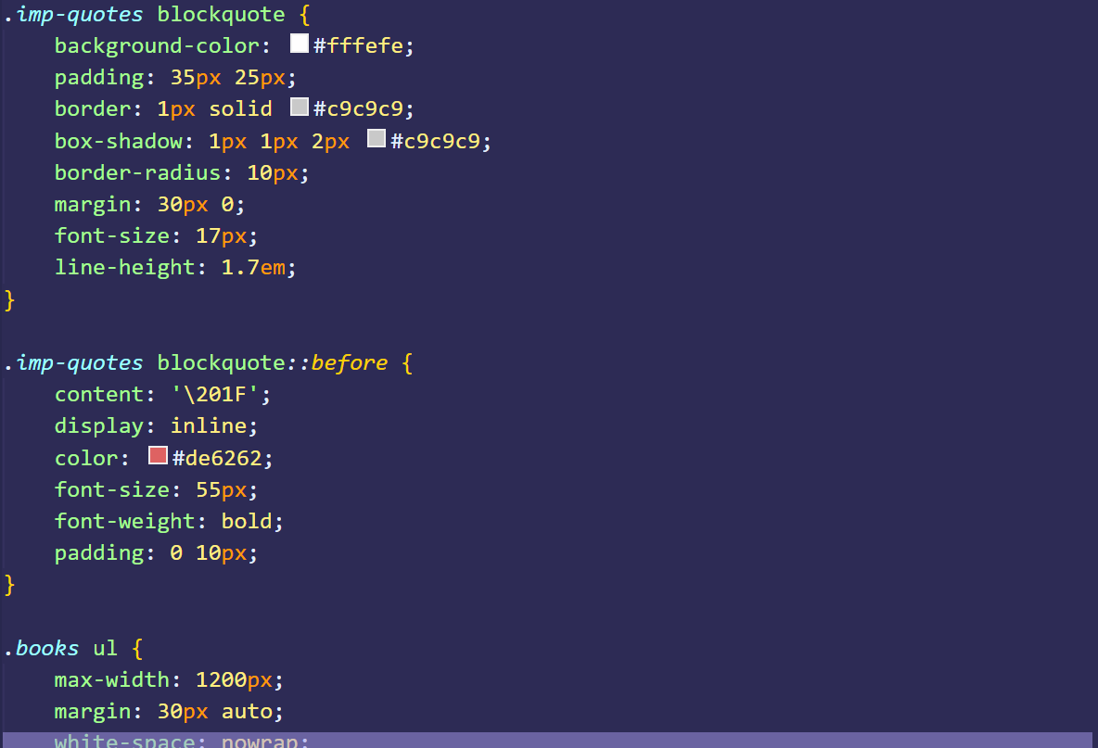

Slide 21
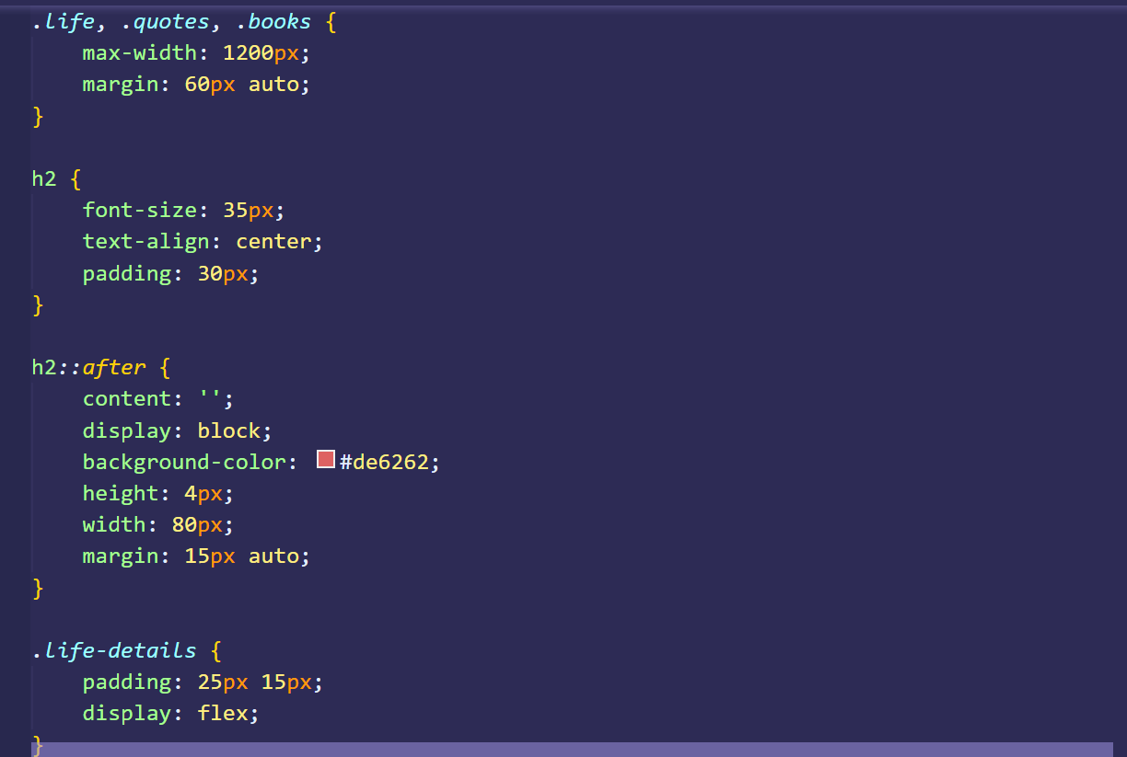

Slide 22
Conclusion
In conclusion, creating a tribute page to the late Dr. APJ Abdul Kalam using HTML and CSS was a rewarding and challenging experience. Throughout this project, I learned the importance of incorporating engaging content, while ensuring that the page was functional and accessible across different devices and platforms. I also gained valuable technical skills in HTML and CSS, which will be useful in future projects.
By researching and compiling information about Dr. Kalam's life and achievements, I was able to gain a deeper understanding of his contributions to science, education, and public service. Through the design elements of the tribute page, including images and colors, I aimed to convey a sense of respect and admiration for his legacy.
Overall, this project was a meaningful way to honor the memory of a remarkable individual, and to showcase the power of technology in sharing his inspiring story with a wider audience. I hope that this tribute page will serve as a fitting tribute to Dr. APJ Abdul Kalam and inspire others to learn more about his remarkable life and work.

Slide 23
References/Links used
Website/Article Name | Link
Product pages on shopify | https://www.shopify.com/examples/product-pages
web page examples | https://unbounce.com/landing-page-examples/
Tribute Page examples | https://blog.hubspot.com/marketing/landing-page-examples-list
Crazy eggs’s guide to Landing pages | https://www.crazyegg.com/blog/landing-page-examples/
Pexels | www.pexels.com
YouTube | in.youtube.com

Slide 24


